Slide 1
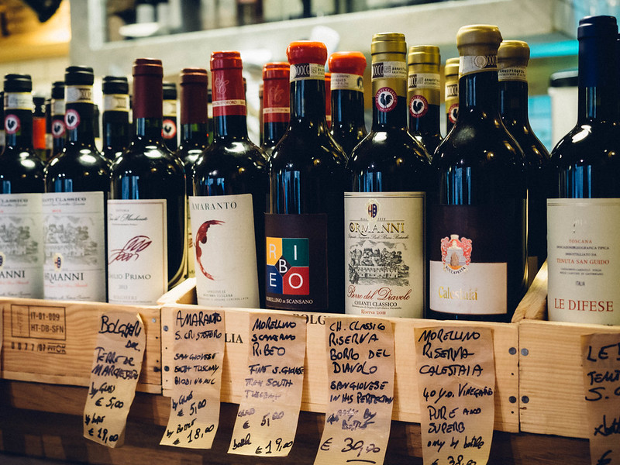




Different Machine Learning Algorithms for Wine Dataset
Presented By:
Emmanuel Chibua
Jay Shukla
Di Xiao

Slide 2
Background
The quality of wine is a crucial aspect for both consumers and the wine industry. However, the conventional method of measuring wine quality is time-consuming.
As machine learning models have gained significance in replacing human tasks, we aim to explore the essential wine features to achieve desirable results using these models.
To accomplish this, we have employed Decision tree regressor, XGboost, and Random forest regressor for evaluation of relevant features.
The dataset will be split into training and testing sets, with the training set being used to train model and the testing set to evaluate its performance. We will also implement Grid search hyper parameter adjustment to improve the model's accuracy.
This project emphasizes the importance of selecting the appropriate machine learning algorithm for a particular dataset to obtain optimal outcomes and identify new features.

Slide 3
Why The Dataset is Interesting?
The wine dataset is interesting because it provides a rich source of information for exploring the world of wine and developing machine learning models for wine recommendations. This dataset is interesting for two reasons below:
1)The dataset contains a large number of observations, including different varieties of wine, points, and descriptions.
2) The dataset has been cleaned and preprocessed, which makes it easier to work with and reduces the amount of time required for data cleaning and preparation.

Slide 4
What is Problem?
1) Can we use the algorithm to predict the price of some kind of wine? Using points? And how is the relevant algorithm’s performance like?
2) How to compare the results? If the results are not as match as we expected. what should we do to next step? Is that enough as we only select three algorithms?

Slide 5
Methods
Decision Tree Regressor
XGboost
Random forest Regressor

Slide 6
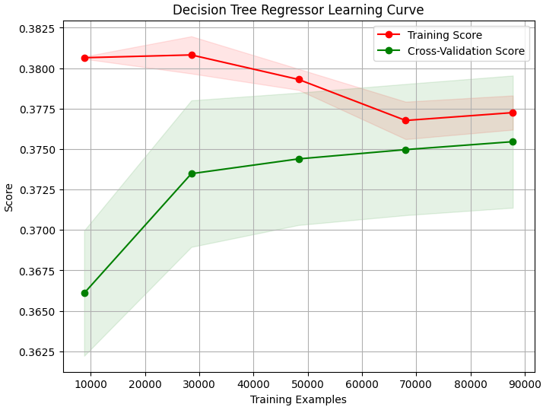
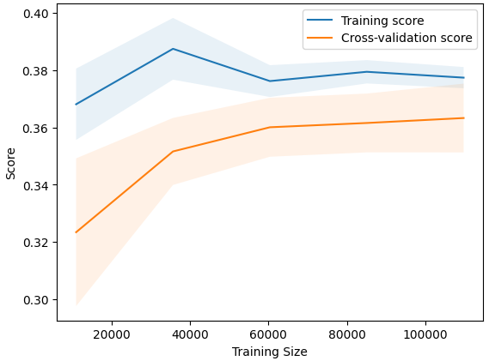
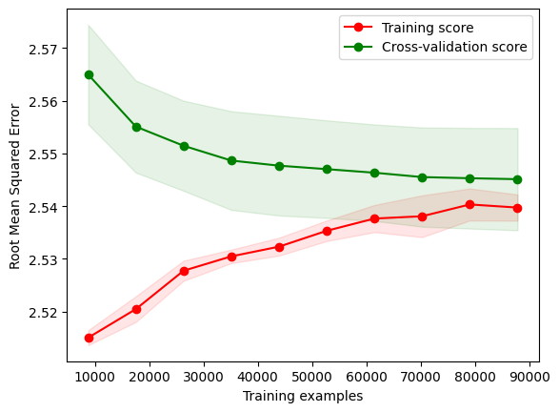
Results

Slide 7
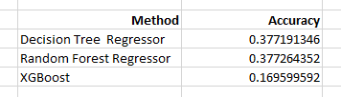
Results
Notes:
Based on the evaluation of the model performance using the same dataset in this project, it can be concluded that the Decision Tree Regressor and Random Forest Regressor have similar accuracy. However, the Random Forest Regressor outperforms the Decision Tree Regressor in terms of accuracy. The XGBoost model, on the other hand, has the lowest performance compared to the Decision Tree Regressor and Random Forest Regressor. Therefore, based on the given dataset, the performance order of the models would be Random Forest Regressor with the highest accuracy, followed by Decision Tree Regressor, and then XGBoost with the lowest accuracy.
We also can not make some conclusions that Decision Tree and Random Forest Regressor algorithms will predict the price of some kind of wine.

Slide 8
Conclusions
based on the given dataset, the performance order of the models would be Random Forest Regressor with the highest accuracy, followed by Decision Tree Regressor, and then XGBoost with the lowest accuracy.
We also can not make some conclusions that Decision Tree and Random Forest Regressor algorithms will predict the price of some kind of wine
In future, when selecting an algorithm to analyze a particular dataset, it is important to consider the specific requirements and characteristics of the problem at hand. After knowing more machine learning algorithms, we can start to compare or analysis the performance of the algorithms
It is important to keep in mind that the performance of a model can be influenced by many factors, including the quality and representativeness of the data, the feature selection and engineering process, and the choice of evaluation metrics

Slide 9

Thank you!

